Slide 1


Slide 2
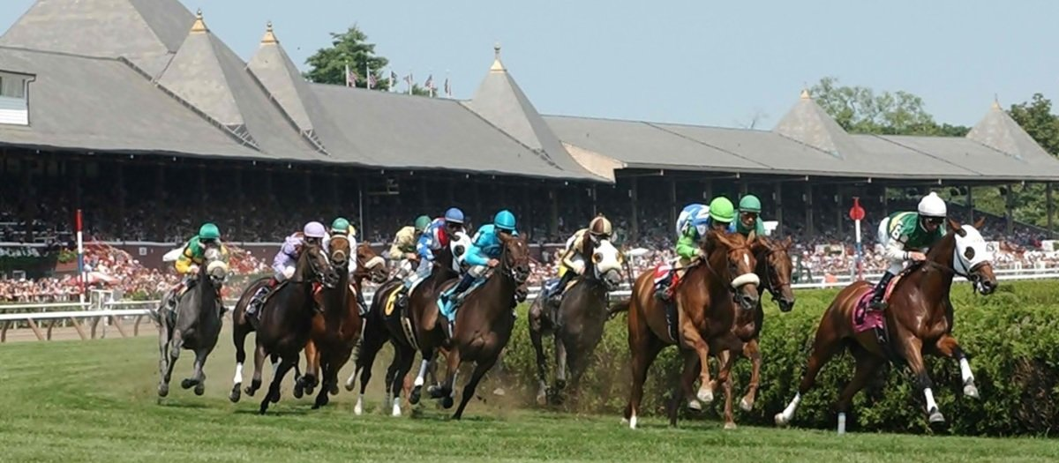

Racetrack Infractions and Incidents
Joyce Woznica IST 652
Analysis of rule violations and incidents at New York State horse racetracks from 2009 - 2019
Notes:
I'm here today to talk about horse racing - specifically in New York State - and rule enforcement to help determine if proper rule enforcement can lead to the betterment of the sport.
To explain:
Each race conducted at a New York Thoroughbred or Harness racetrack is observed by three individuals who play the role of a referee or umpire.
These people have viewing stands that are equipped with several television monitors to allow viewing of multiple angles of each race.
They observe the races and the race grounds to make sure that all conduct is in accordance with rules and regulations.
The hope is that with citing individuals that are breaking the rules will help minimize risk and accidents to horse and human. Better understanding of this information can provide insight into what might need a deeper look.

Slide 3
Data Sources
New York State Racetrack Rulings from 1985 to Present
Source: https://data.ny.gov/Government-Finance/Horse-Racing-Rulings-Beginning-1985/igam-2tkj
New York State Racetrack Incidents from 2009 to 2020
Source: https://data.ny.gov/Government-Finance/Equine-Death-and-Breakdown/q6ts-kwhk
Twitter
Various hashtags and accounts
Notes:
The following data was used for this analysis which is available on the NY state government website.
- New York State Rulings
- New York State Incidents
- Twitter Data
All years prior to 2009 and after 2019 were removed from both data sets to concentrate on a single decade of time.
I also reviewed Twitter and found the account for each NYS racetrack along with overall NYS Gaming Commission and other related accounts.
I also found various hashtags that were associated with the tracks.

Slide 4
Program Description
1: Package Import
2: Data Load and Manipulation
3: Structured Data
3.1: Analysis
3.2: Visualization
4: Unstructured Data
4.1: Analysis
4.2: Visualization
5: Merging of Data Sets
5.1: Analysis
5.2: Visualization
Notes:
Just a brief overview of the structure of the Python program I created:
Package import section - which loads all the various packages required for the entire program
Data Load and Manipulation - this is where I loaded from csv into pandas data frames and removed unnecessary information
Structured Data - I then did some descriptive analysis on the structured information and associated visualizations to understand the data and answer some general questions
Unstructured Data - In this section, I reviewed the unstructured text in the data set as well as twitter. Twitter data was loaded into MongoDB and then certain information was then stored in a pandas dataframe for analysis. I completed some visualizations for the unstructured data in this section.
Merging of the Data Sets - this was a significant step - to review any overlap of infractions and incidents. Data was merged by Date and Track

Slide 5
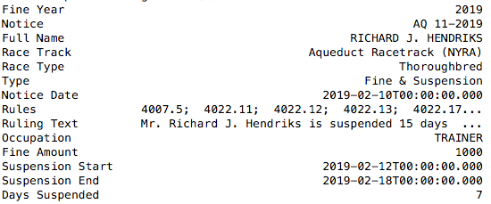
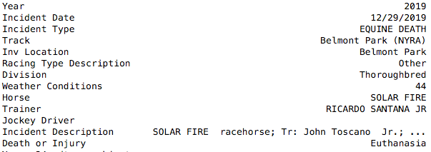
Data Snapshots
Rules (Infractions) Dataset
11,516 rows, 14 columns
Incident Dataset
4,152 rows, 13 columns
Notes:
This provides a snapshot of the data in included in the data sets
CLICK - the Infraction or Rules Dataset is the primary set used for this project It details the what rules are broken by whom, when and where as well as the consequences.
CLICK - there was just over 11 thousand 5 hundred rows each with 14 columns in this data set.
CLICK - the Incident Dataset was used for final analysis and details information about accidents on the track - like equine injury, death, racing incidents, etc.
This data set captures similar information including the individuals involved and the date and track.
CLICK - there is around 4 thousand 150 rows each with 13 columns in this data set.

Slide 6
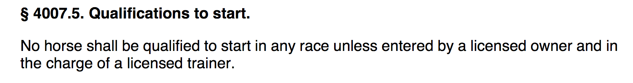
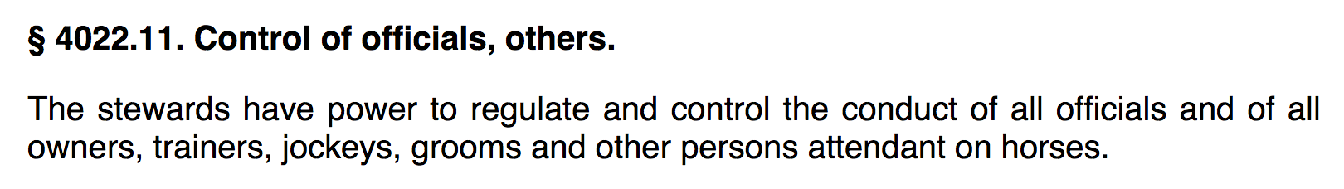
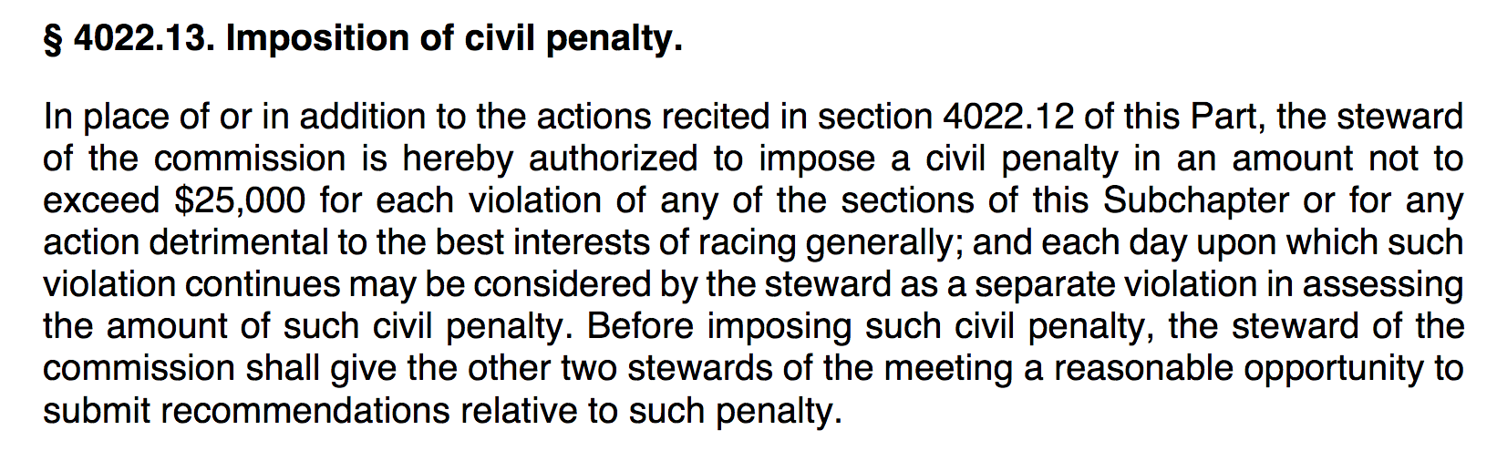
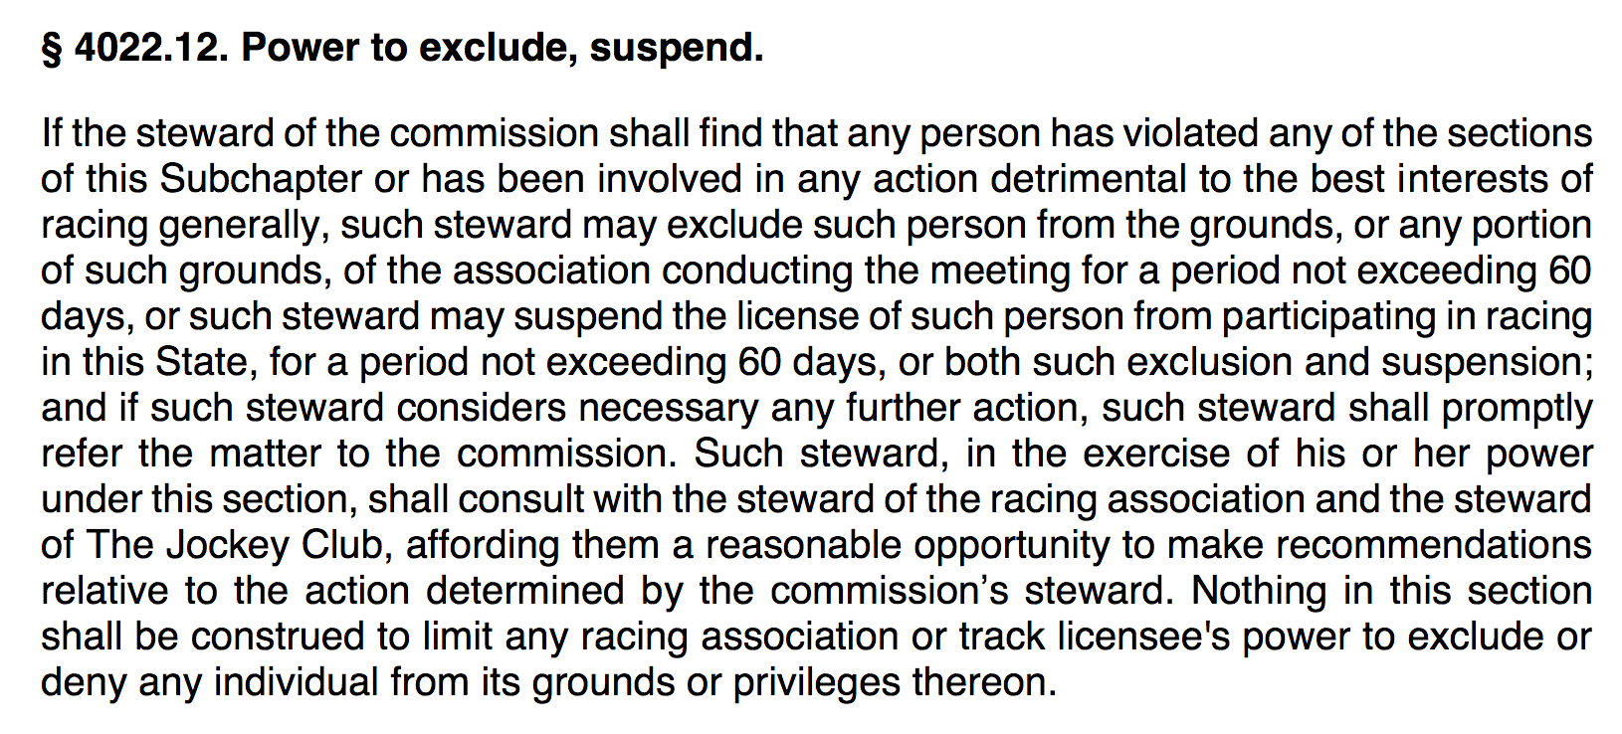
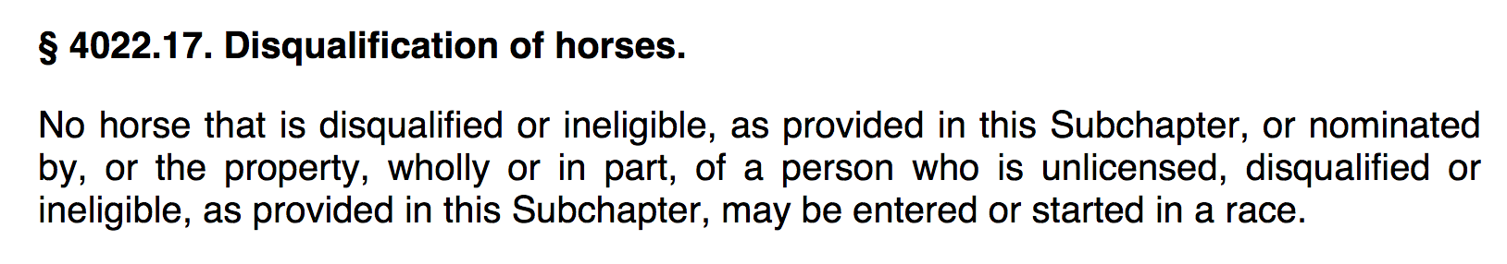
Example Rules
Notes:
To better understand this information, here are some of the rules that were mentioned in the previous example datapoint for Richard J. Hendricks.
Looks like he presented a horse to race that was ineligible or the horse was handled by someone that was ineligible to participate.
These are formality-type rules, but still important.

Slide 7
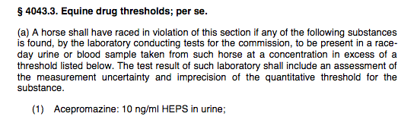
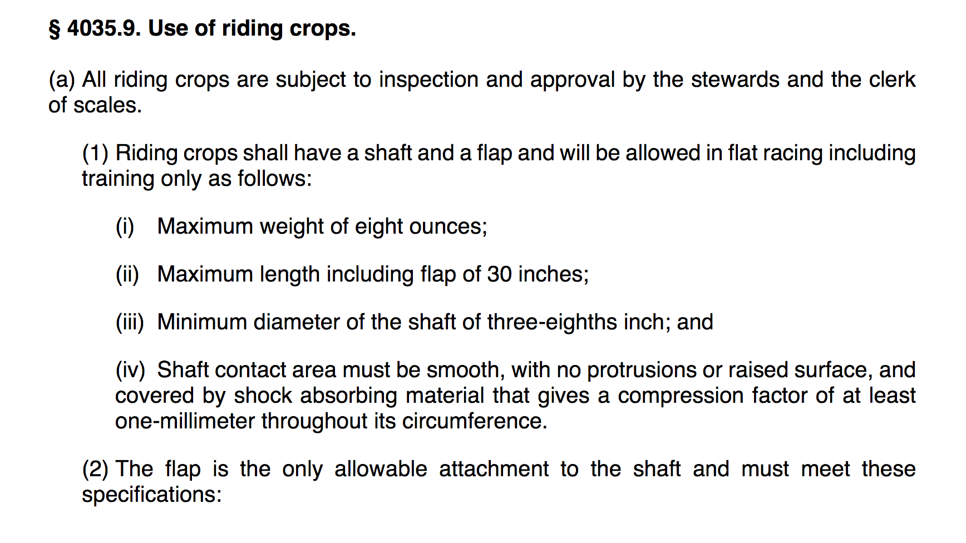
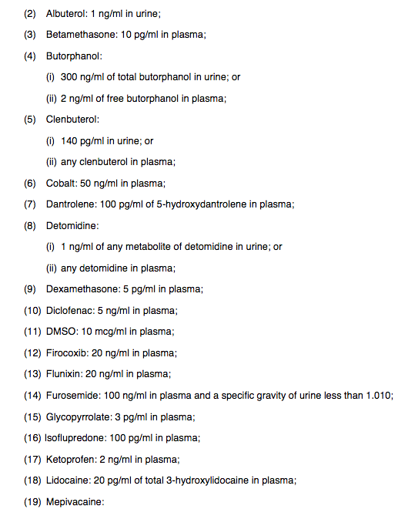
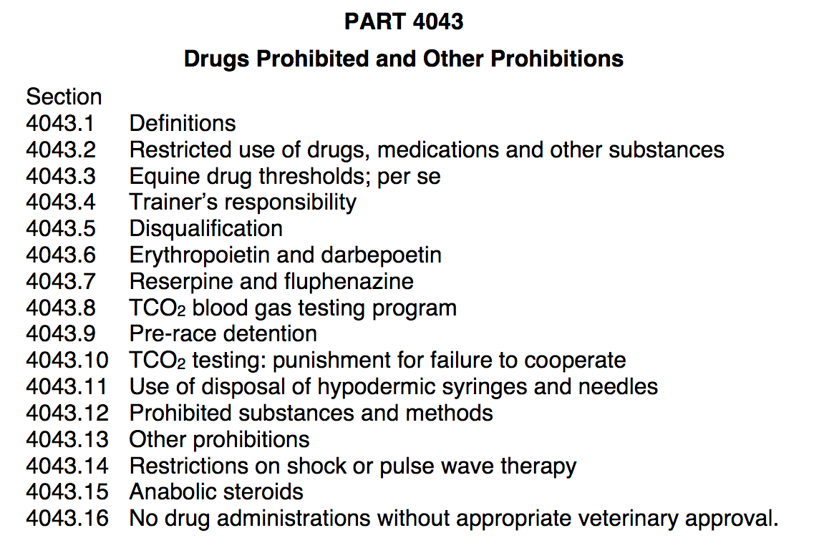
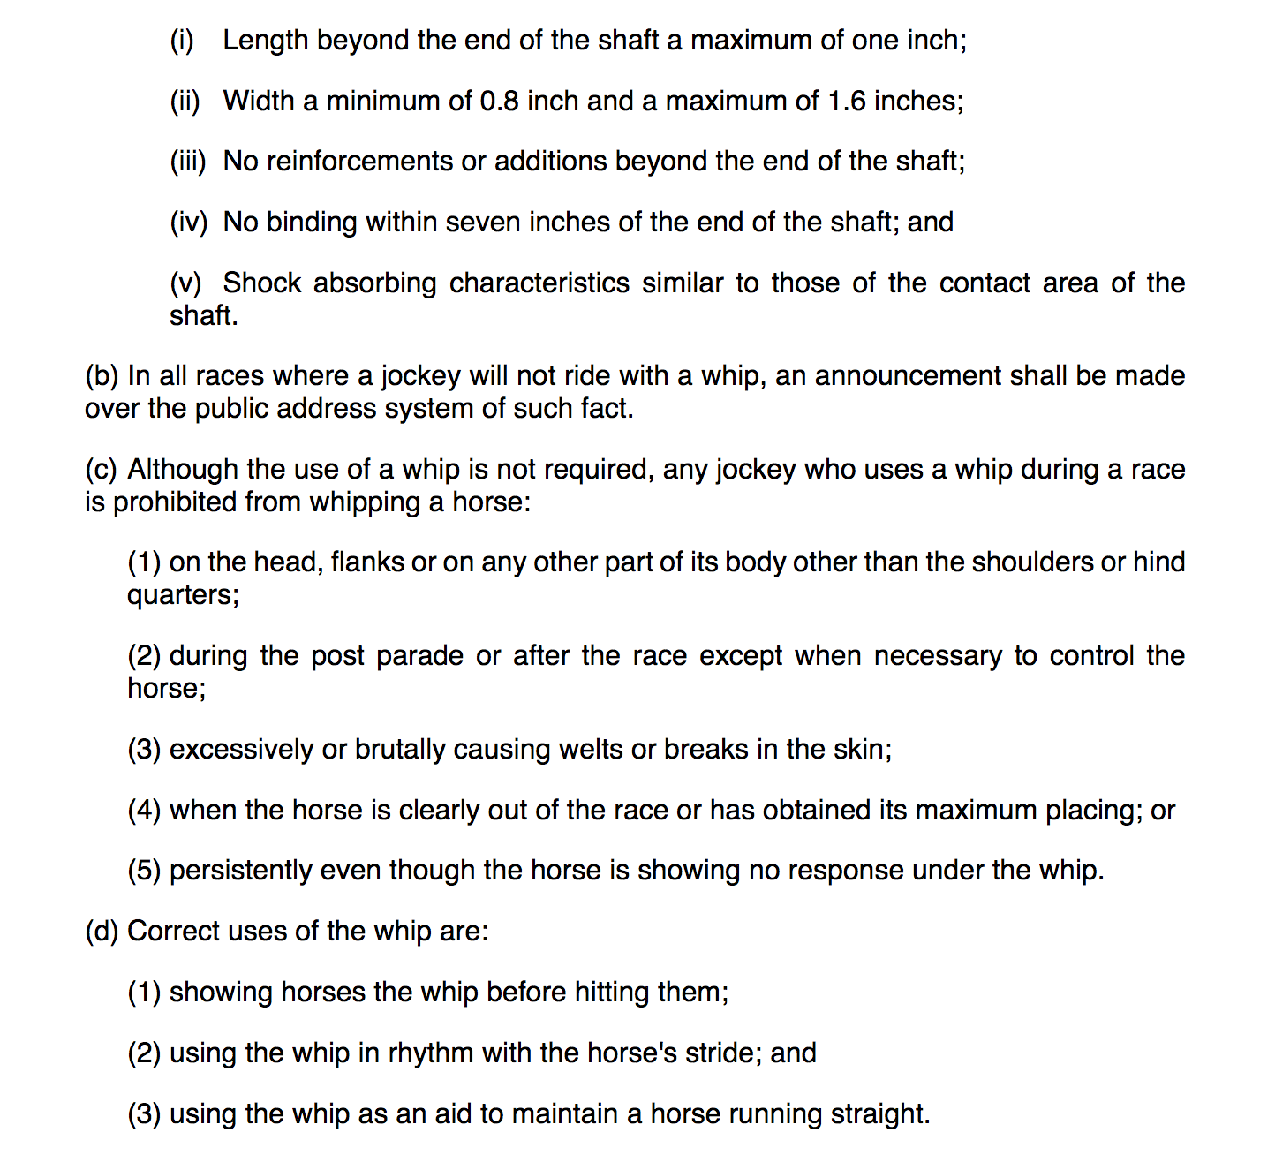
Example Rules
Notes:
There are also rules that are more for the welfare of the horse.
CLICK - for example - you will notice that not only are their specifics on the types of crops that can be used,
CLICK - but how they can be used on a horse.
CLICK - In the United States Equestrian Federation (USEF) (the governing body over our US Olympic Equestrian Team and my daughters, actually) - drugging of horses is strictly forbidden. Horses are athletes and as a result - enhancing drugs or drugging to minimize pain arel forbidden.
CLICK - This is similar when it comes to racing
CLICK - You can see here that Albuterol (like for Asthma)
CLICK - and Dexamethoasone (for allergies) are forbidden in certain quantities because they act a bit like speed.
CLICK - Lidocaine, on the other hand - is also forbidden because it has pain reducing effects.
This can get very interesting - for example, with USEF, lavender is forbidden because it alters normal behavior by masking the scent of fertile females from eager males.

Slide 8
Do certain tracks have more infractions that others?
Yes:
Yonkers Raceway
Saratoga Gaming & Raceway
Monticello Raceway & Mighty M Gaming
Notes:
The first question was general - do some track have a higher rate of infractions than others?
CLICK
Clearly - yes. As reflected in bar the graph, three (3) racetracks showed a significantly higher number of rule infractions as you can see here.
CLICK
These are all Harness Racing tracks. This was a surprise to me - I expected more rules to be broken on TB tracks.
CLICK - These results led me to the next question.
Is there fluctuations by years and where? This shows a peak of infractions at those same three tracks can you can also see that the same 3 tracks remain high over the entire decade, especially in 2018.
These higher numbers; however, could just be attributed to the number of races and entries at larger tracks.

Slide 9
Were some individuals or roles more likely to violate the rules?
Notes:
Another question was if certain individuals or occupations were higher in violations.
CLICK
So Owners/Trainers/Drivers and Jockeys were likely to violate rules more than say - the Food Service personnel :)
CLICK
And there were some people who just didn't get the point - like Mr. Richard E Dutrow, Jr who had $50,000 in fines over the decade.
BTW - this is the second visualization of this information - the first one showed a Mr. Luis Pena acting as a trainer with almost $350,000 in fines over the decade.
So much for his winnings, huh?
CLICK
And Jockeys had the highest average fine - much less than let's say - the "farrier" - the one that puts shoes on the horse

Slide 10
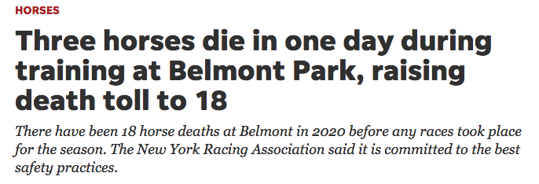
What are people saying? Is racing safe?
Race Track | Associated Accounts and Hashtags
Aqueduct Racetrack | #aqueductracetrack
Batavia Downs | @BDRacetrack, #bataviadowns
Belmont Park | #belmontpark, @BelmontStakes
Buffalo Raceway | @BuffaloRaceway, #buffaloraceway
Finger Lakes Gaming & Racetrack | @FLGaming, #fingerlakesracetrack
Monticello Raceway & Mighty M Gaming | #monticelloraceway
Saratoga Gaming & Raceway | @SaratogaNYRA, #saratogarraceway
Tioga Downs | @gotiogadowns, #tiogadowns
Vernon Downs | @governondowns, #vernondowns
Yonkers Raceway | @YonkersRaceway, #yonkersraceway
All Tracks | @racingwrongs, @HR_Nation, @TheNYRA, @NYSGamingComm, @NYRABets
Harness Tracks | @trotinsider, #harnessracing
Thoroughbred Tracks | @SireStakesNY, @Equibase
Notes:
So I wanted to see if people talk about the tracks and if they had positive or negative things to say on twitter. As we all know - twitter is a place of strong opinions.
CLICK
These are the twitter accounts and hashtags that were part of my twitter search.
CLICK
Let me preface by saying that this was run last week, so the talk was all about opening the tracks and how beautiful that would be and being excited about the first day of racing would be except for CLICK - Dead - CLICK which can be attributed to the coverage about 3 horses dying in one day training at Belmont Park ...which leads me to Mr. ”@RacingWrongs"
CLICK
This is the result of looking at the top 175 words tweeted by a known entity (@racingwrongs) that posts about the cruelty of horseracing.
Clearly the opinion of @racingwrongs is that horses die, are killed, collapse or are euthanized in this sport.
Not surprising as he has his own agenda.

Slide 11
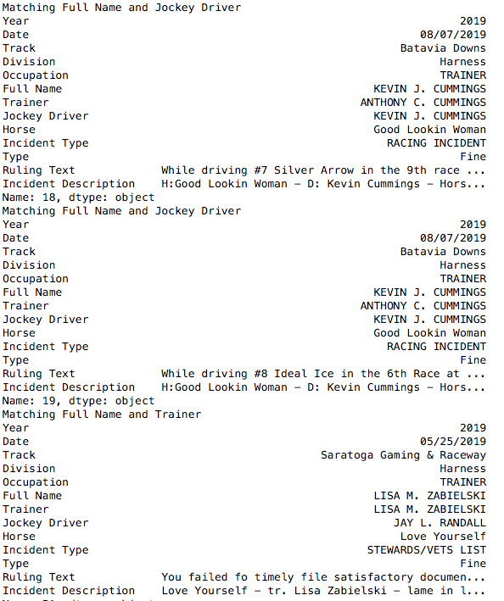
Is there any correlation between racetrack infractions and racetrack incidents?
There is very little correlation between infractions and incidents and the resulting overlap was 59 rows, only 30 days on the same track, with only 3 of the same individuals.
Notes:
The highlight of my project was to see was if there was any correlation to rules being broken and racetrack incidents.
CLICK: There were only 30 dates over the entire decade of over 11,000 infractions where a violation was issued on the same day as a racing incident on the same track.
CLICK: But this was the interesting part - in all of those thousands of infractions and incidents - only 3 times was the same person, on the same day at the same track involved.
CLICK, CLICK And in this situation - Mr. Cummings' incident at the track was NOT with the same horse that was cited for breaking the rules.
CLICK CLICK
CLICK - it was unclear if Ms. Zabielski was involved in the same situation - one horse was lame, and the infraction was missing documentation.
CLICK, CLICK - so very little correlation and not much overlap in an entire decade!

Slide 12
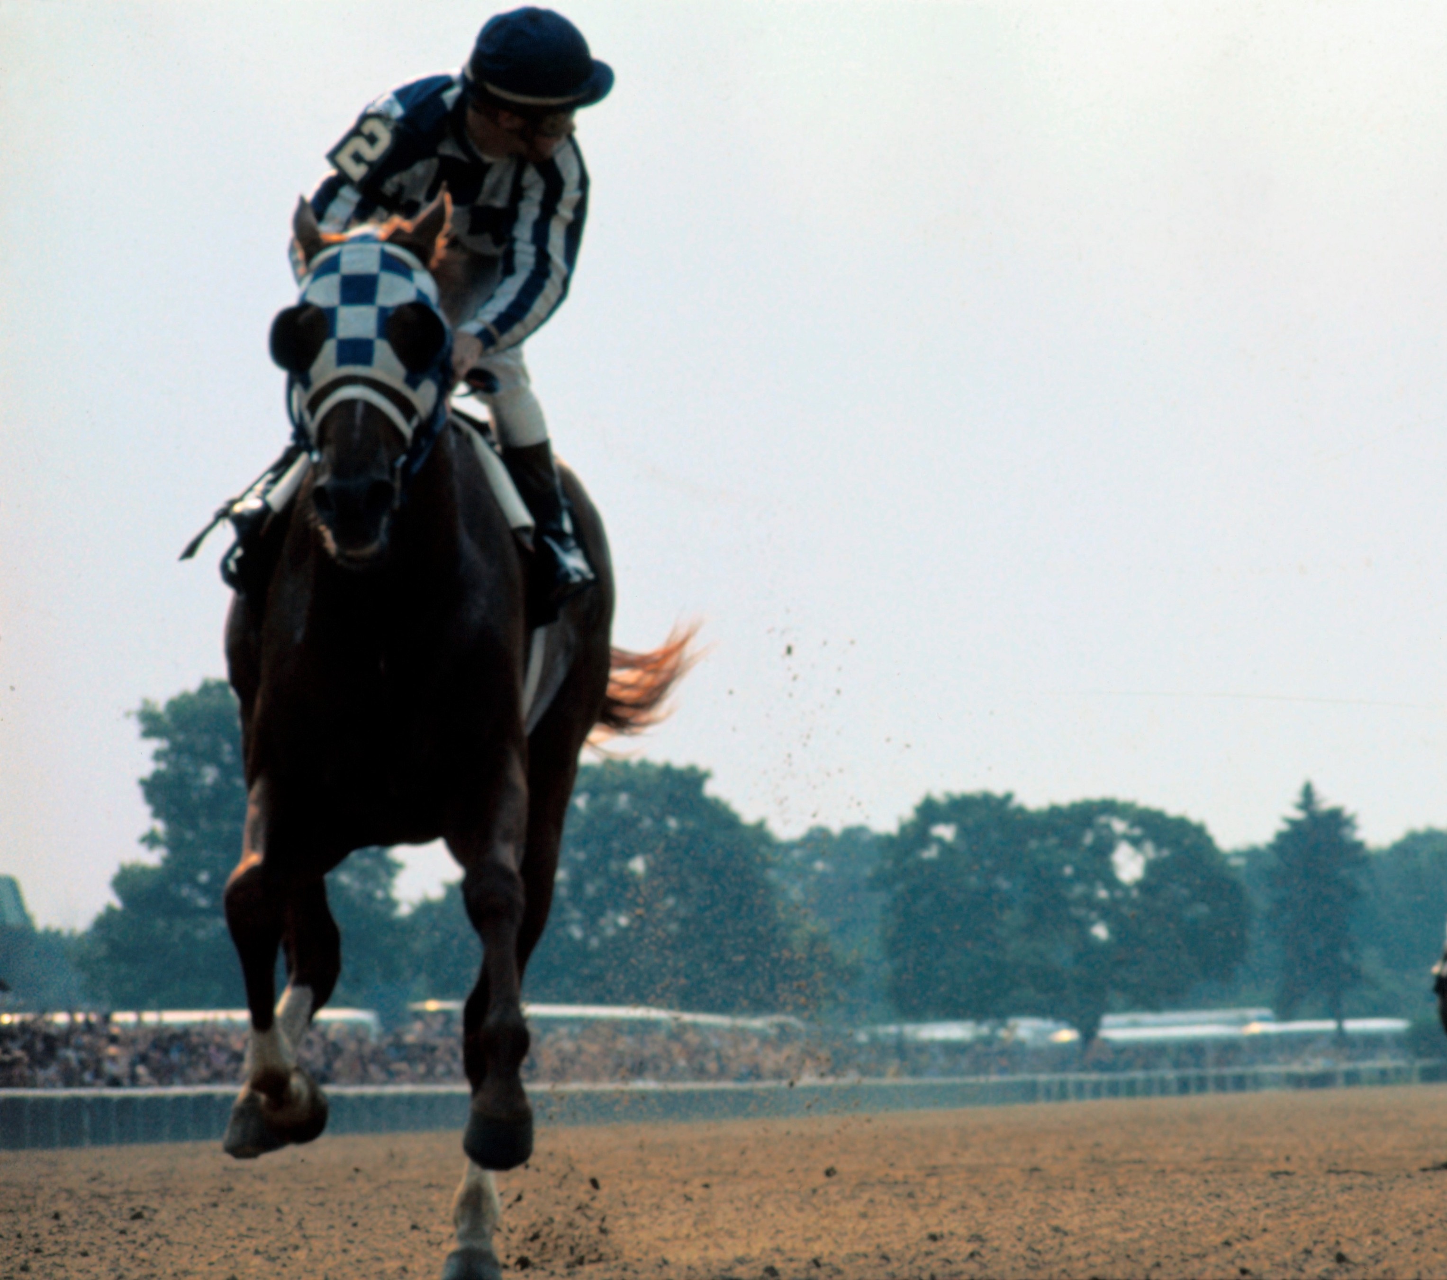
Conclusion
There was minimal overlap of infractions and incidents.
This could be because:
When the rules are being enforced – less accidents happen
When people see others being fined or suspended, they are more careful at the track. Either would be positive as it would make racing safer.
Implies that racing is getting safer as a sport overall because of enforcement of these rules.
Notes:
The biggest surprise - and probably the most positive information gathered - was the lack of incidents when infractions were taking place.
This could be beause
when the rules are being enforced – less accidents happen. Or
that when people see others being fined or suspended, they are more careful on the track.
CLICK: Either would be positive as it could mean that racing safer.
And for those of you not familiar, this picture is of the great Secretariat at Belmont Park (last leg of the Triple Crown) where he won by 31 lengths in a time of two minutes and 24 seconds (144 seconds) for 1 ½ miles - that is 37.5 MPH, more than two seconds faster than any horse had run the race in history.

Slide 13
Next Steps
What are the most common rules that are broken?
Can you predict the rule(s) violated by looking at the ruling text?
Notes:
I would love to do a little more investigation around the actual rules and also if you can predict which rules are broken based on a description of the event.

Slide 14
Thank you
Notes:
Thank you everyone for your time today and I just want to conclude by saying - I’m not a fan of horse racing - although I do find it remarkable.
I am pleased to see that there is some improvement being made or a least some attempts are being made in New York State.
And just to add a little more color to my presentation - jumping is more our family equestrian passion
And here are my daughters doing what they love :
CLICK - on the left, Ellie on her horse No Fault of Mine (Berkeley)
CLICK and on the right, Lauren on her horse Untouchable (Chicago) …
CLICK and a token picture of my boy "Secret Decision" (Sully).

